Slide 1
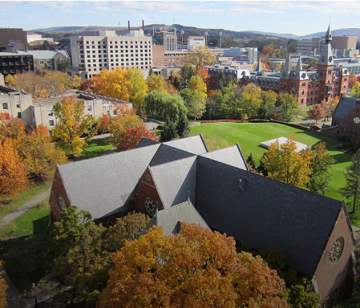
Promoting ORCID Adoption in the Academic Institutional Ecosystem: Progress Reports from Adoption & Integration Partners
Christopher Shanahan
Violeta Ilik
Katherine Chiang
Kristi Holmes
cornell.edu

Slide 2
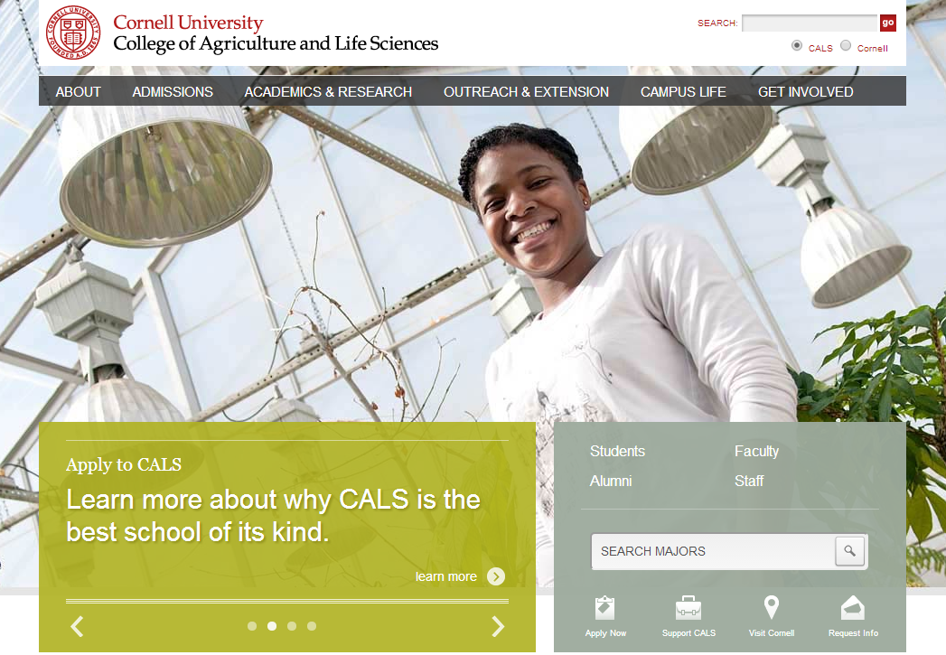
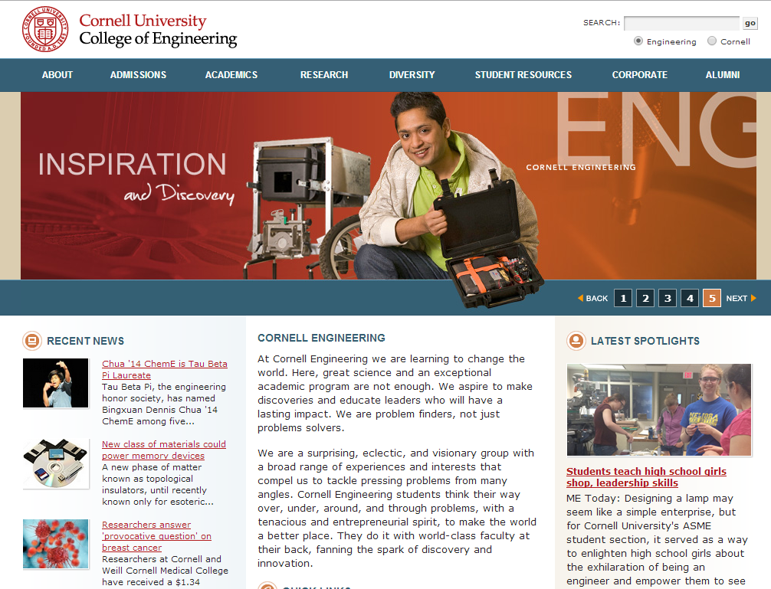
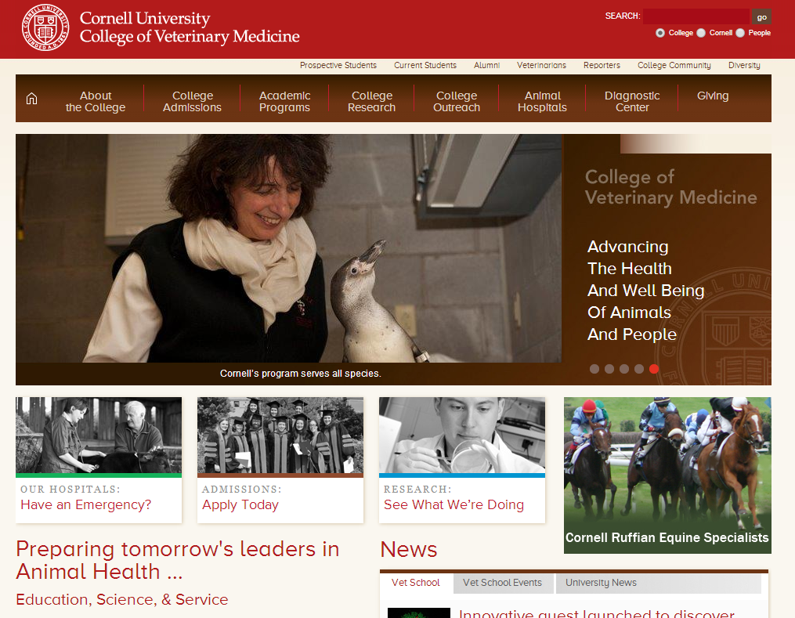
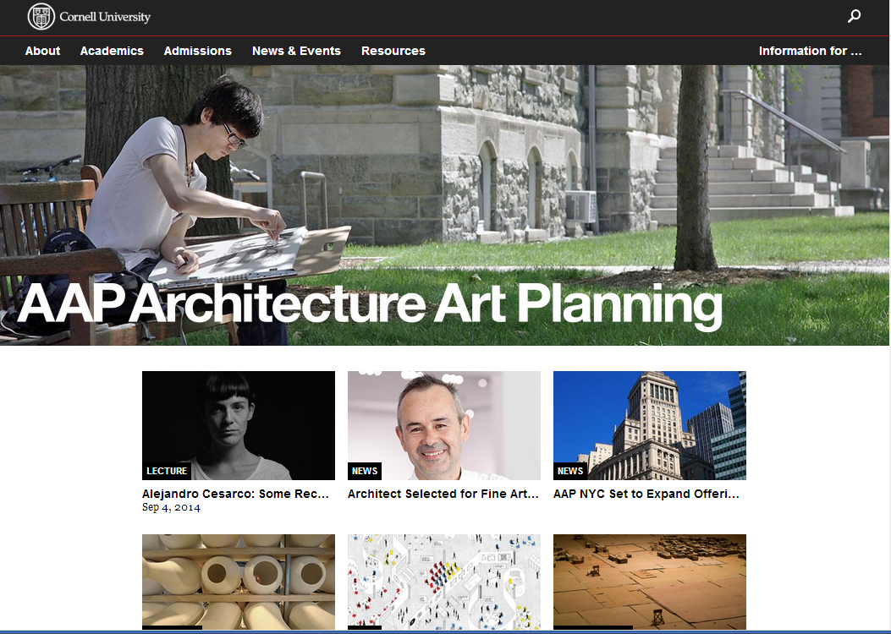
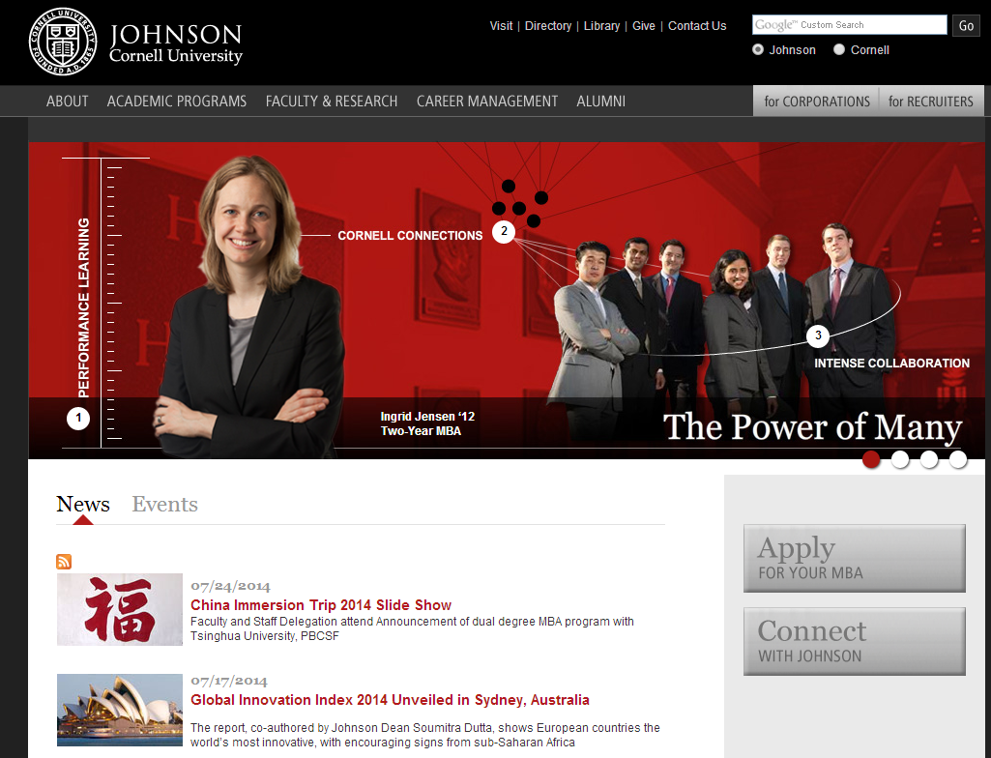

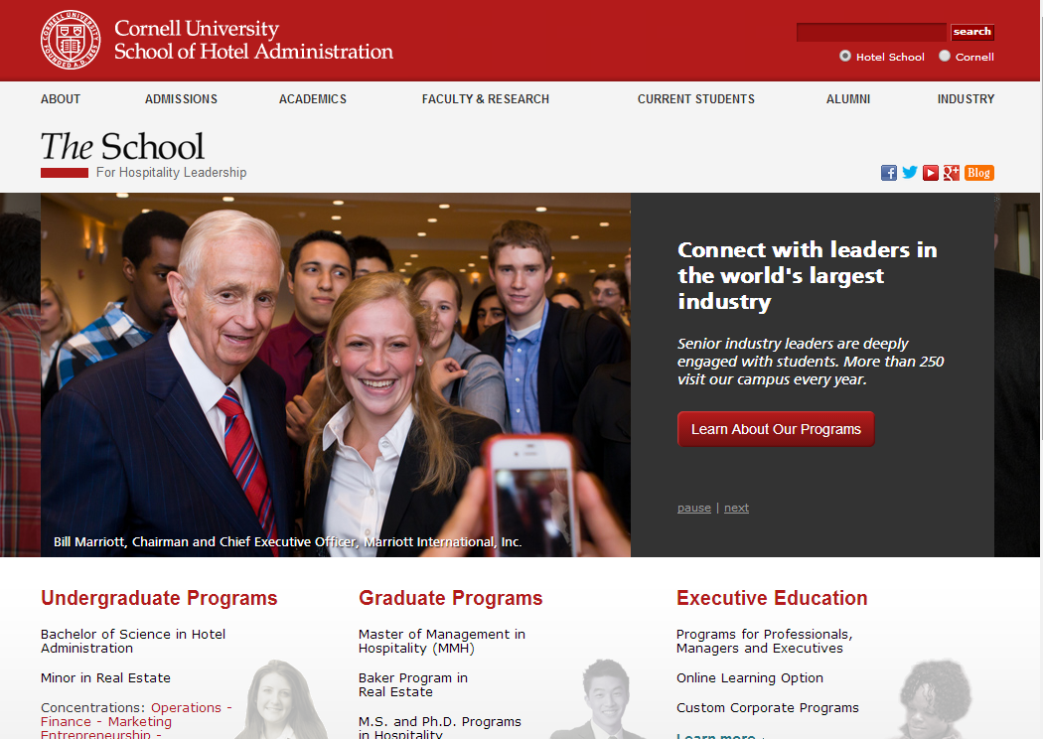
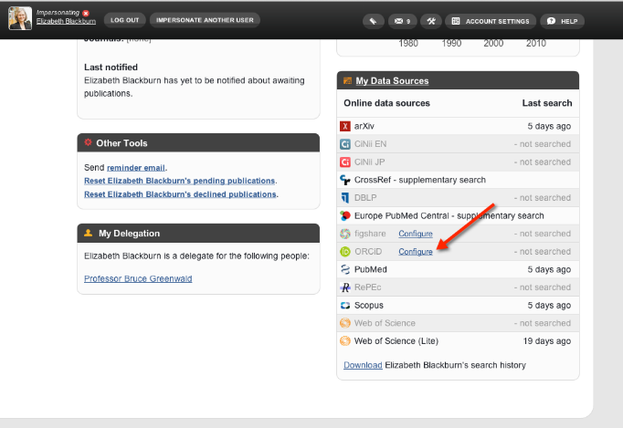
Activity Insight & Symplectic Elements + ORCID + VIVO

Slide 3
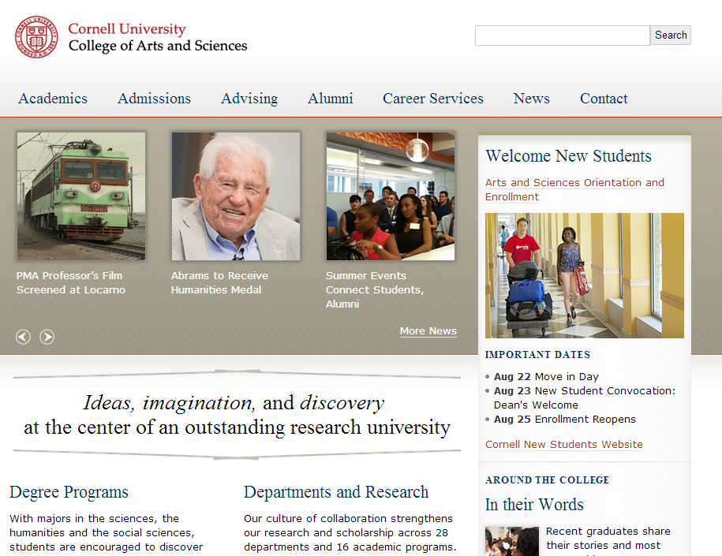

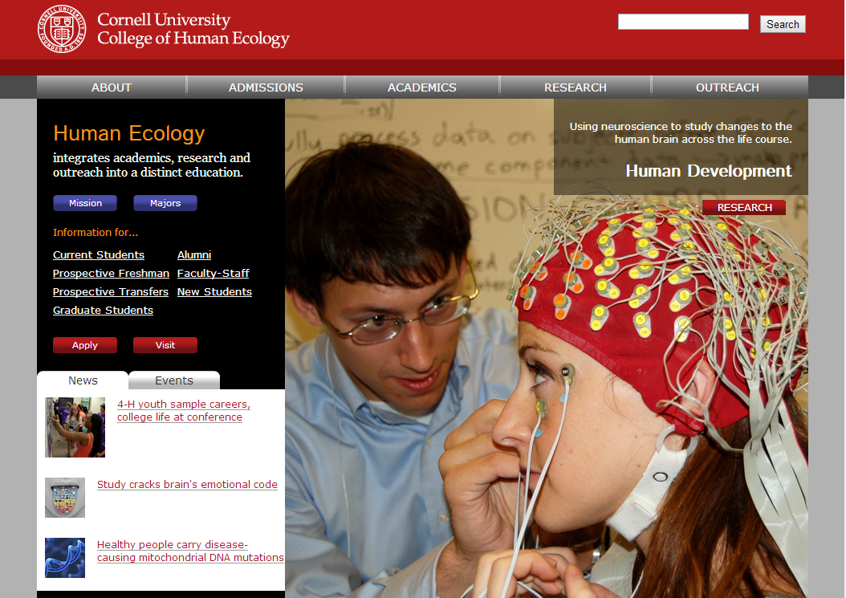
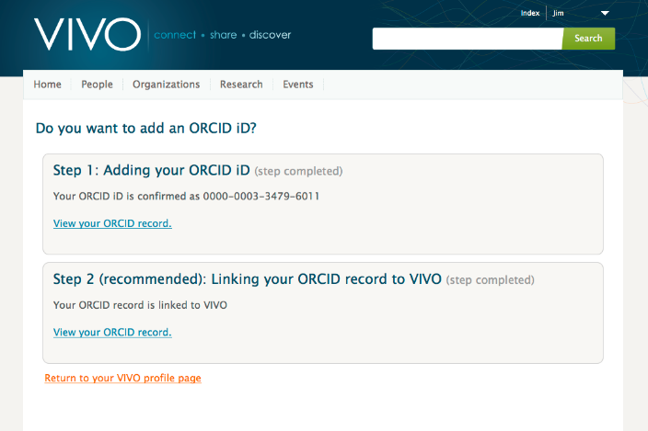
Activity Insight & Symplectic Elements + ORCID + VIVO
VIVO + ORCID

Slide 4
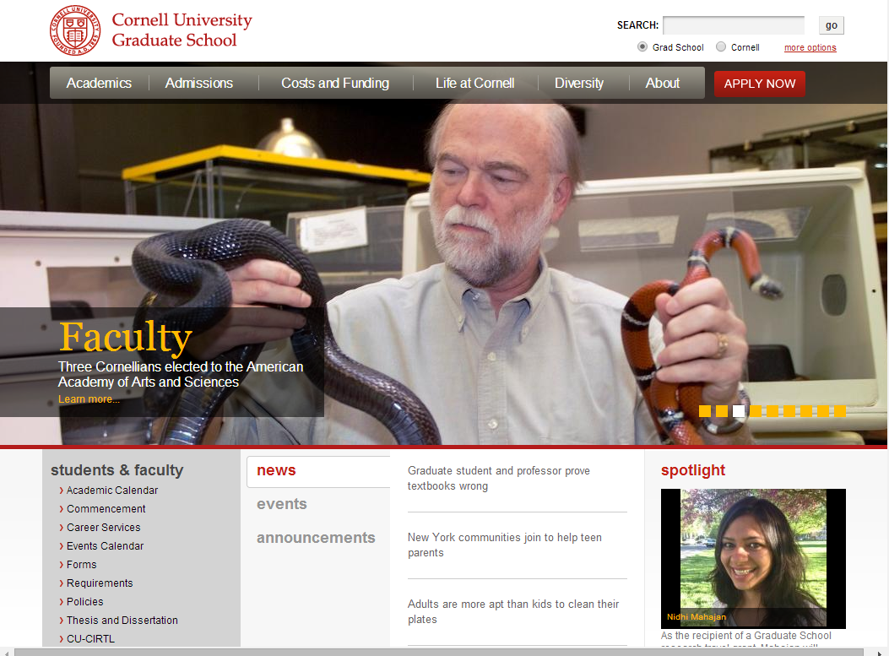
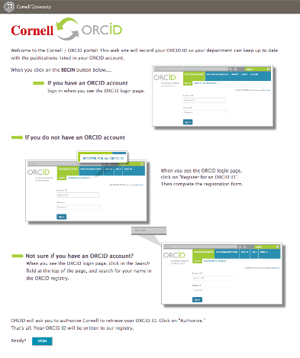
Activity Insight & Symplectic Elements + ORCID + VIVO
VIVO + ORCID
ORCID + Cornell

Slide 5
Cornell ORCID team Jim Blake Kathy Chiang Jon Corson-Rikert Dean Krafft Deb Schmidle Simeon Warner Tim Worrall

